Slide 1

Link
https://github.com/woojin444/EAssetTracking

Slide 2

PROJECT AUDIT ONE
E Asset Tracking
Group Members: Alisha, Dillon, Franklin, Jordan, Rob & Woojin

Slide 3
Team Roles
Name | Role
Alisha Boniface | - Hardware, Scheduling, Quality Control
Dillon McGrath | - Hardware, Ergonomics, Meeting Scribe
Franklin Wilson | - Hardware, Audit Slides, Team Communication
Jordan Schaeffer | - Hardware, Software, Parts
Rob Whittaker | - Team Manager, Software, Repo Maintenance
Woojin Ra | - Client Communication, Software, Repo Maintenance

Slide 4
Client’s Vision and Objective
To improve efficiency and safety of workers in mines or oil rigs
To develop an Asset Tracking system that will
Ensure the safety of staff in both normal work operations and emergency situations
Improve the efficiency of the work site through:
timely asset location management
allocation analysis of personnel and resources

Slide 5

Image 1: Simple Demonstrative picture of tracking system

Slide 6

Key Stakeholders
Thales
Project Team
Oil and Mining Companies
Oil and Mining Employees
Image 2

Slide 7




Project Scope
Preliminary market research revealed existence of multiple systems that offer personnel tracking
Project will look into (subject to change):
optimising these existing systems for the oil rig environment
processing data from these systems to improve efficiency
creating a device to demonstrate our analysis

Slide 8

Project Deliverables
[Client & Stakeholder Expectations]
Market Analysis
What is currently available on the market?
Can it be developed using COTS components?
Other competitors in the area?
High-level system design
Requirements generation/analysis
Functional flow/breakdown
System/Subsystem interfaces
Operational prototype
Image 3

Slide 9
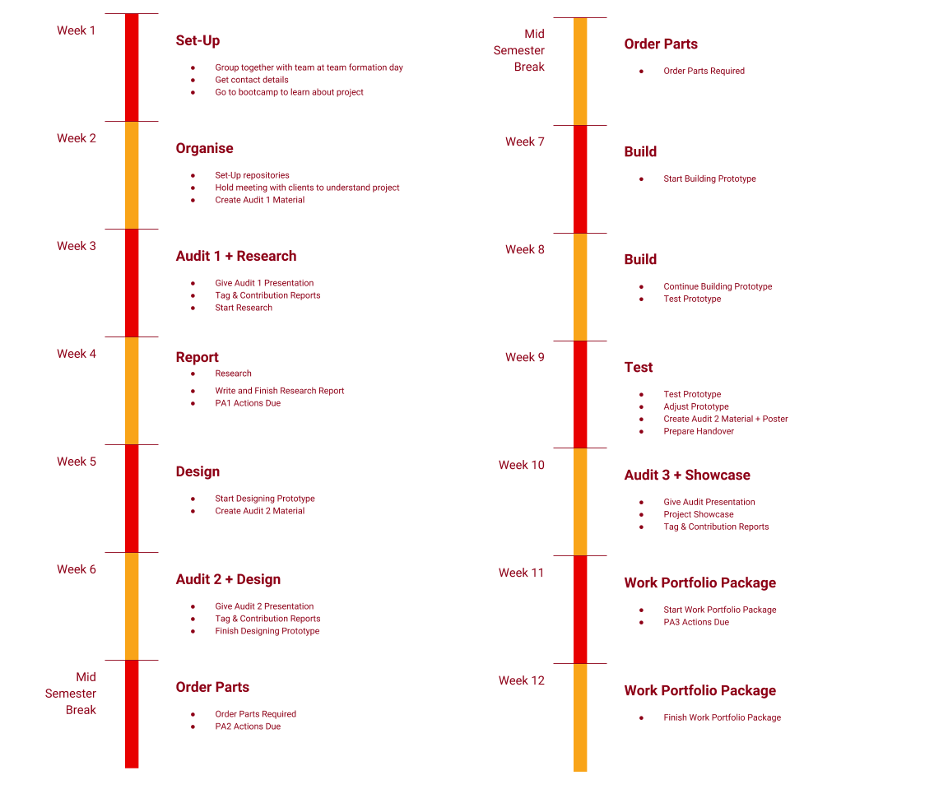
Project
Schedule

Slide 10
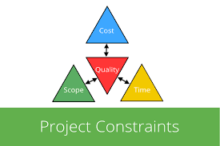
Constraints
Resources
$100 ANU budget
Risks
Information Security
IP
Safety
NDA
Client defined NDA
Time
Image 4

Slide 11




Tools

Slide 12
Resources
Image 1: http://spreo.co/asset-and-personnel-tracking/
Image 2: https://www.linkedin.com/pulse/stakeholder-management-construction-industry-girish-kumar-singh
Image 3:
https://www.quora.com/What-are-some-deliverables-associated-with-a-social-media-strategy-campaign
Image 4:
https://www.inloox.com/company/blog/articles/a-guide-to-dependencies-constraints-and-assumptions-part-2-managing-constraints/

